Slide 1
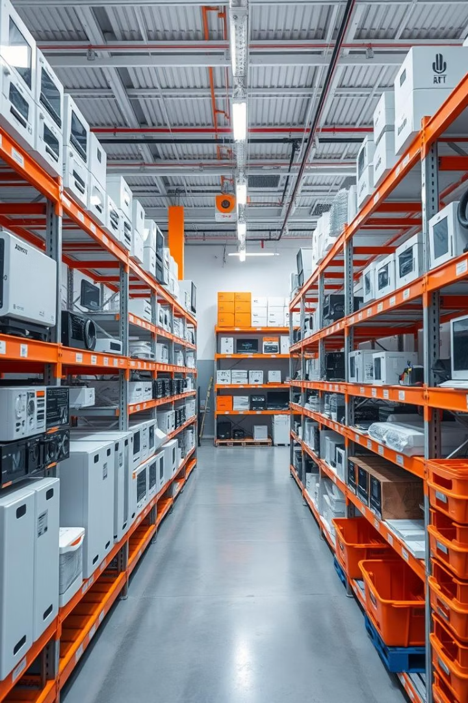

Optimizing Inventory Management & Profitability for Samastipur Electronics
Presented by Harsh Kumar | Roll No.: 22f3001316 | Date: 20-04-2025

Slide 2
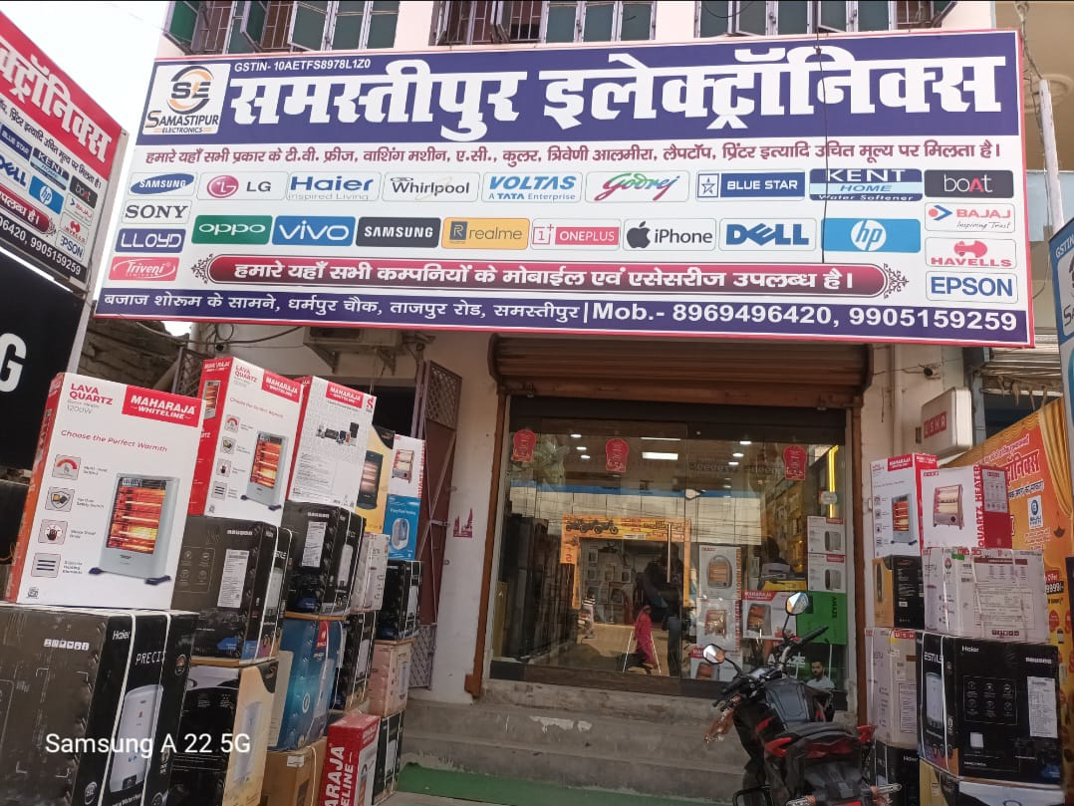
About Samastipur Electronics
A small-scale electronics retail business located in Samastipur, Bihar, India
Operates on a B2C model, serving local customers
Product range includes:
Air Conditioners
Refrigerators
Fans
Mobile Phones
Other electronic appliances
Letter from organization in letter head with stamp and sign
Link:- https://drive.google.com/file/d/1tEgMSzZDAfpDLxSCsB8yLpzKsmvdIfSP/vie w?usp=sharing

Slide 3
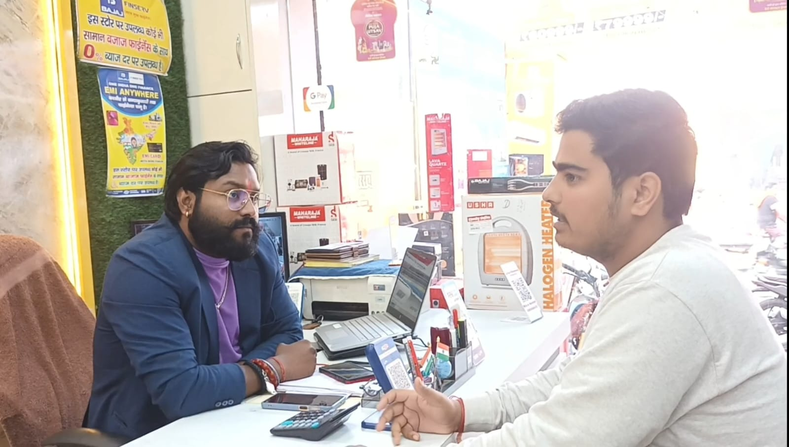
Problem Statement: Key Challenges
Cash Flow Blockage
Profit Leakage
INR 34.7L tied in slow-moving ACs and Fridges
Low-margin products dominate stock, high-margin understocked

Slide 4
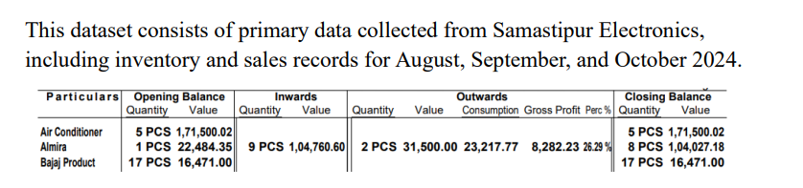
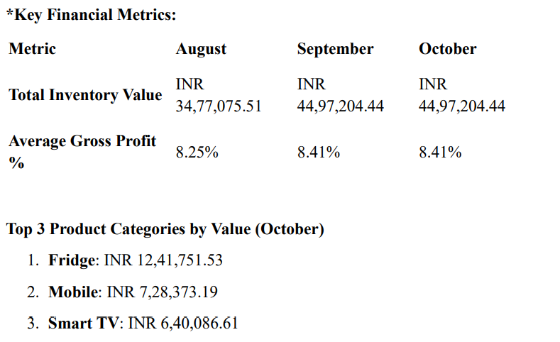
Data Collection and Statistics Description

Slide 5
Methodology Overview
Inventory Turnover Analysis
Ratio of COGS to average inventory levels
Profitability-Turnover Matrix
Quadrant-based product prioritization approach
SARIMA Forecasting
Seasonal demand prediction model for December
Customer Segmentation
RFM analysis identifying revenue-driving segments

Slide 6
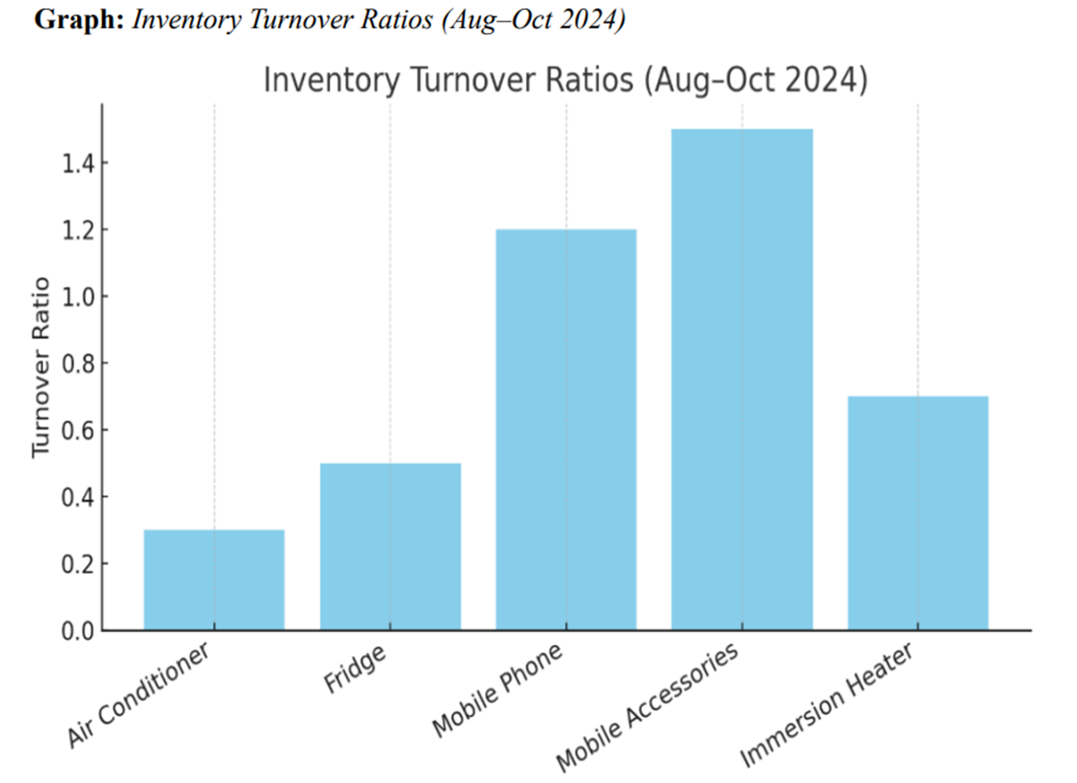
Inventory Turnover Analysis
Slow-Moving Products
ACs turnover: 0.3
Fridges turnover: 0.5
Fast-Moving Products
Mobiles turnover: 1.2
Business Impact
High holding costs: INR 24.5K for AC stock

Slide 7
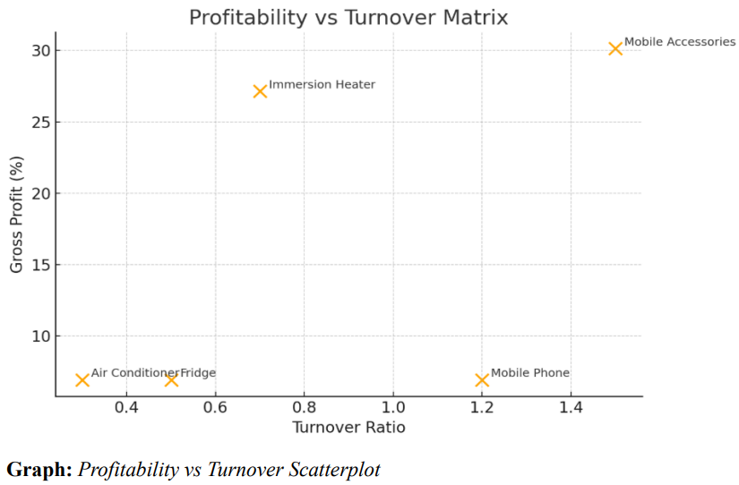
Profitability-Turnover Matrix
Star Products
Cash Traps
Mobile Accessories: 30% margin, high turnover
ACs: 6.94% margin, low turnover
Recommendation
Liquidate low-margin, slow-moving items promptly

Slide 8
SARIMA Demand Forecasting
Key Insight
Data Limitations
Projected 10% December demand surge in Mobile Accessories
Short 3-month dataset, model validated with RMSE 6.25, MAE 4.82

Slide 9
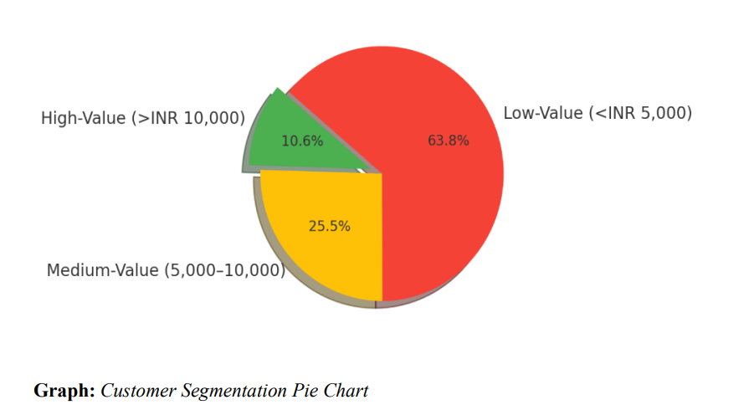
Customer Segmentation (RFM Analysis)
High-Value Segment
Medium-Value Segment
50 customers contributing 50% of revenue
120 customers identified with upsell potential
Strategy
Implement loyalty programs targeting top customers

Slide 10
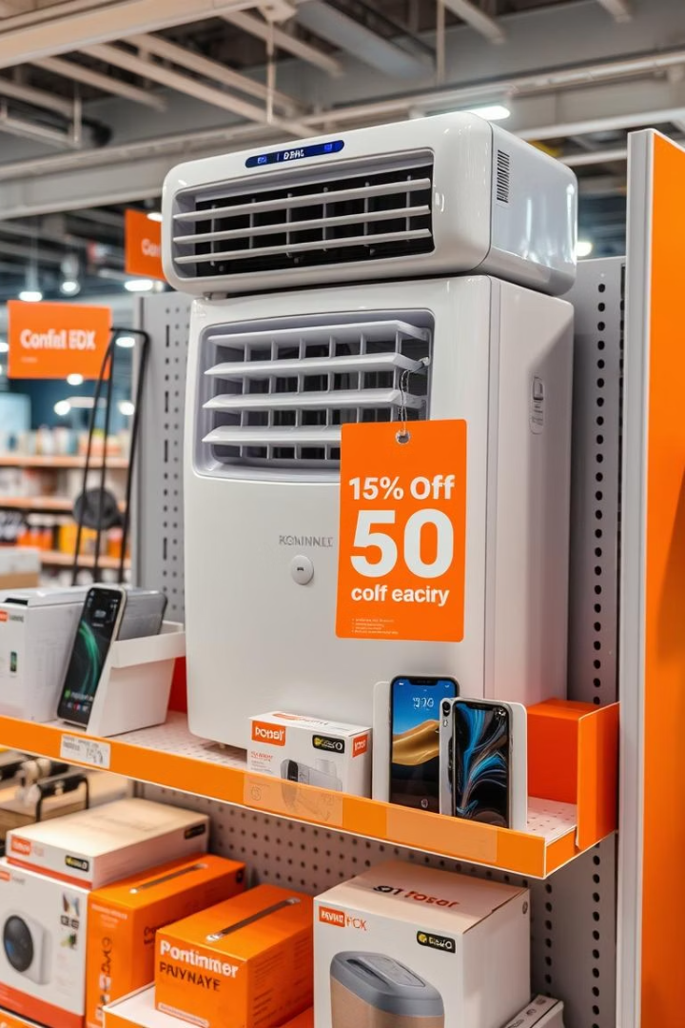
Dynamic Pricing & Bundling Strategies
Dynamic Pricing
Bundling
Adjust AC and Fridge prices during peak seasons
Offer INR 300 discount on AC + Mobile Accessories bundles
Expected Impact
Margin improvement of 5–6%

Slide 11
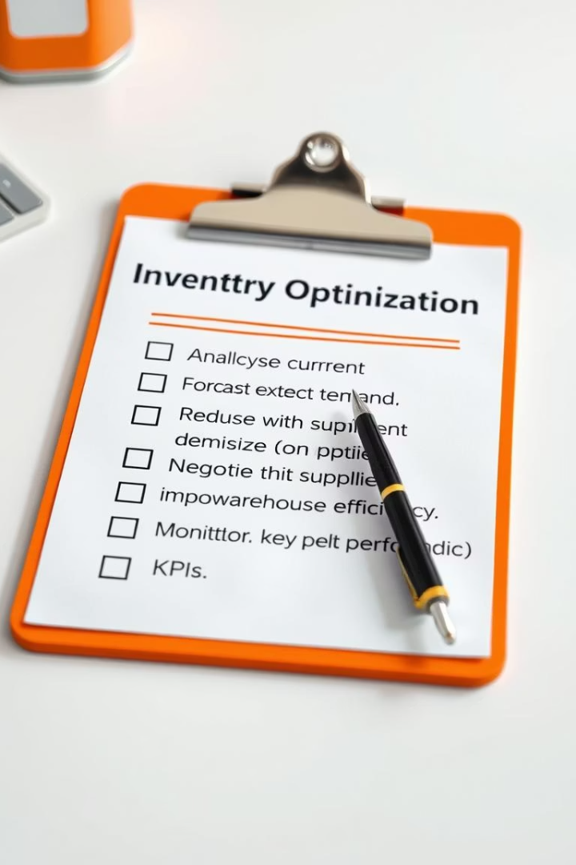



Recommendations: Action Plan
Liquidate Slow-Moving Stock
Free INR 3.5L capital from ACs and Fridges
Increase High-Margin Inventory
Stock 100+ Mobile Accessories for December
Launch Loyalty Programs
Target high-value customers to boost revenue

Slide 12
Expected Outcomes & Q&A
Gross Margin Growth
Capital Freed
Reduced Stockouts
Thank You!
10–15% increase expected post-implementation
INR 3.5L available for reinvestment
Better inventory management during peak seasons
Q&A Invitation: I’m happy to address any questions!

